Slide 1
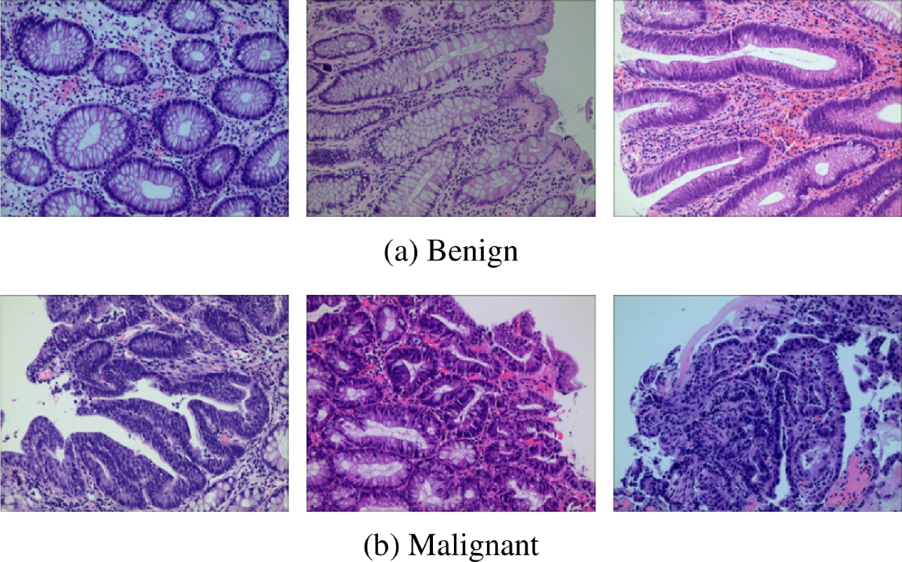





Explainable Vision Transformers for Histopathological Cancer Detection
Aya Gharsalli & Ferdaws Saidi
Under the supervision of Dr. Khemaies Abdallah
Deep Learning Course

Slide 2





Clinical Challenge: Cancer Detection in Histopathology
The Problem
Critical
Manual cancer detection is time-consuming, subjective, and requires specialized expertise
LC25000 Dataset
15,000 histopathology images • 768×768 resolution • 3 organ classes
Two Classification Tasks
Task 1: Colon
Task 2: Lung
Binary Classification
3-Class Classification
Benign vs Adenocarcinoma
Benign vs Adenocarcinoma vs Squamous
Benign vs Malignant Tissue Structures

Slide 3

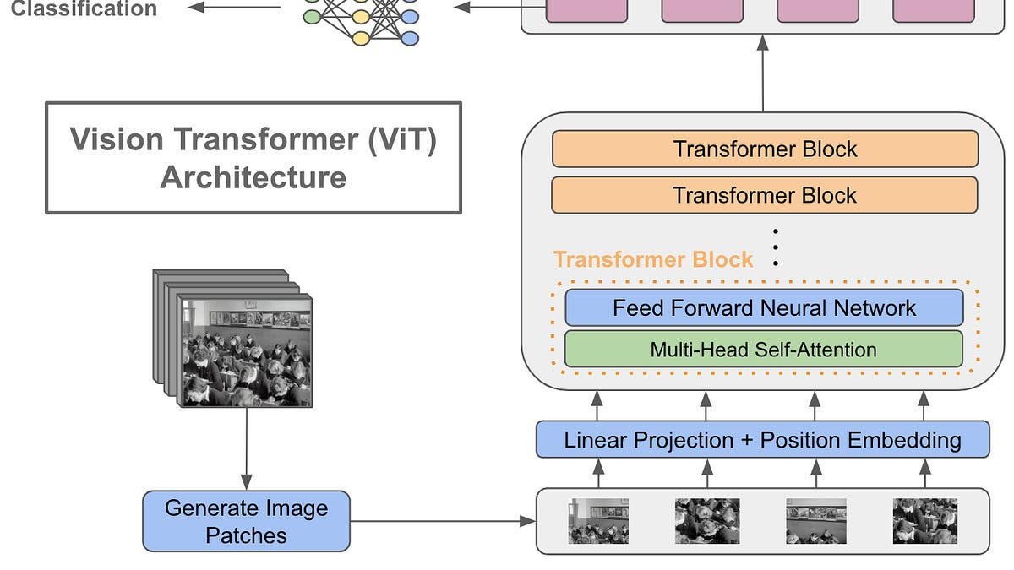




ViT-B/16: From Patches to Predictions
Patch Embedding
16×16 patches → 196 tokens + CLS token
Transformer Encoder
12 blocks • 768-dim embeddings • 12 attention heads
Classification Head
Linear(768→2) Colon
Linear(768→3) Lung
Transfer Learning
Pre-trained on ImageNet-21k • 86M parameters • Fine-tuned on LC25000
ViT Architecture Flow: Patches → Encoder → Prediction

Slide 4

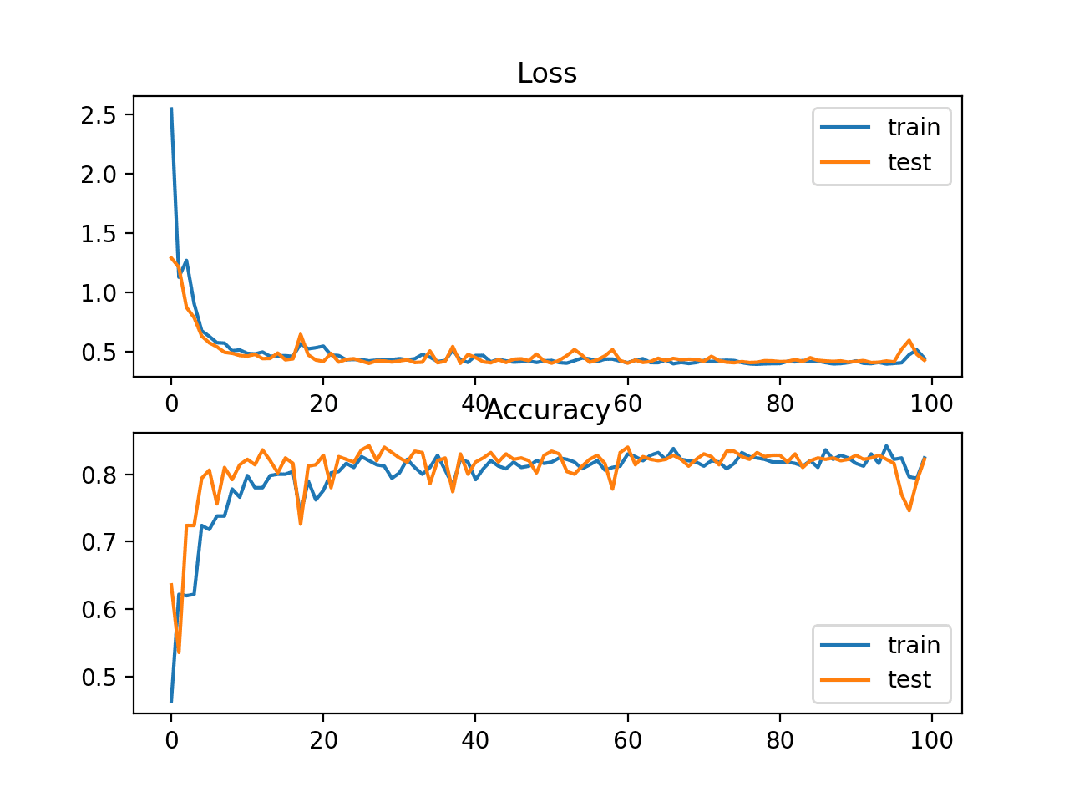






Optimization Pipeline for Medical Imaging
Converging
AdamW Optimizer
lr=2e-4 • weight_decay=1e-4 • Decoupled weight decay
Cosine Annealing LR Scheduler
Smooth decay • T_max=15 • Prevents abrupt convergence
Class-Weighted Cross-Entropy Loss
Handles class imbalance in lung 3-class task • Compensates minority classes
Aggressive Data Augmentation
RandomHorizontalFlip
RandomVerticalFlip
ColorJitter
RandomRotation(15°)
Best Model Checkpointing
Save model with highest validation accuracy
Cosine Annealing Schedule: Smooth LR Decay

Slide 5



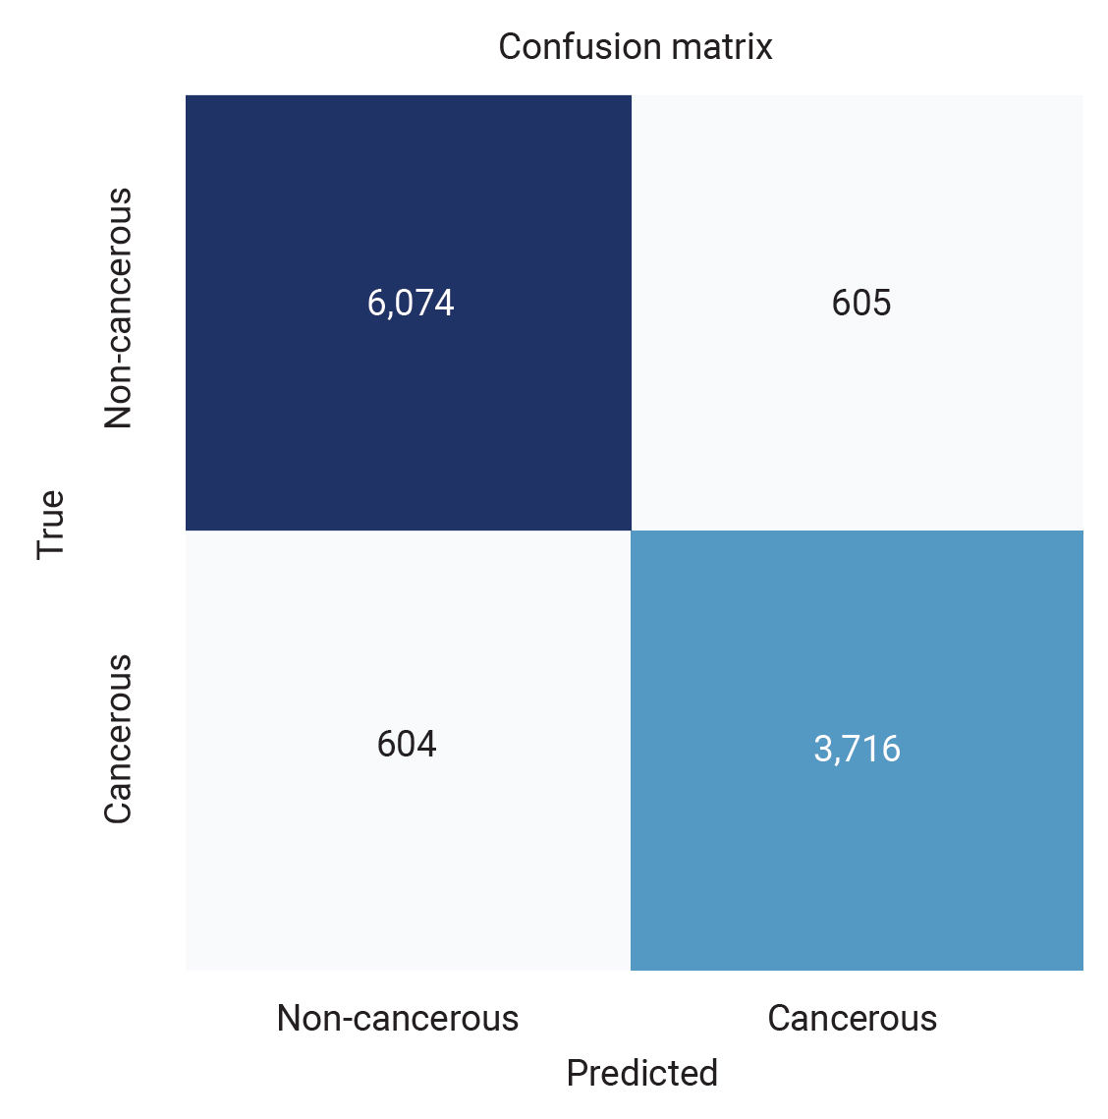
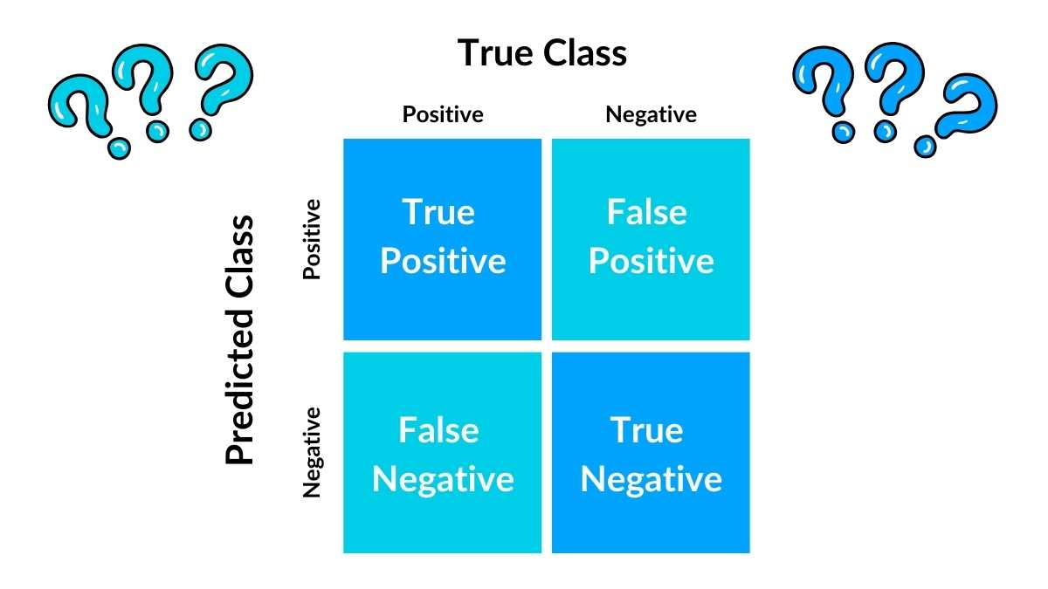

Clinical-Grade Performance
Colon Classification
Test Accuracy
99.93%
Macro F1-Score
0.9993
Binary: Benign vs Adenocarcinoma
Lung Classification
Test Accuracy
Colon: Binary Classification
Lung: 3-Class Classification
99.82%
Near-perfect diagonal
Robust across subtypes
Macro F1-Score
Key Insight: Near-perfect discrimination between benign and malignant tissues across both organ sites
0.9982
3-Class: Benign vs ACA vs SCC

Slide 6



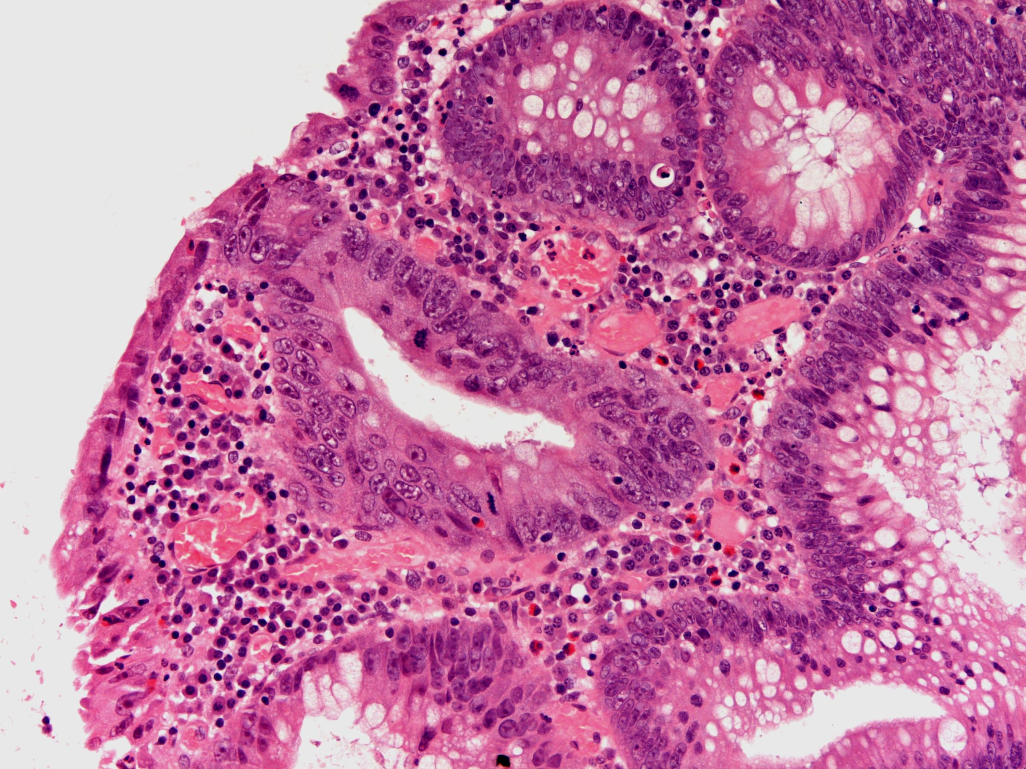
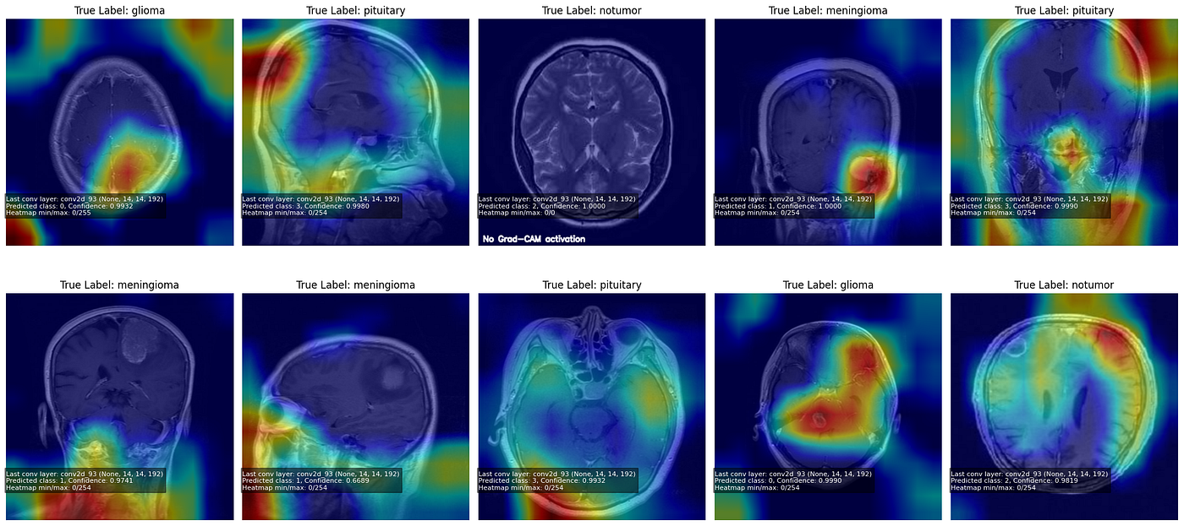
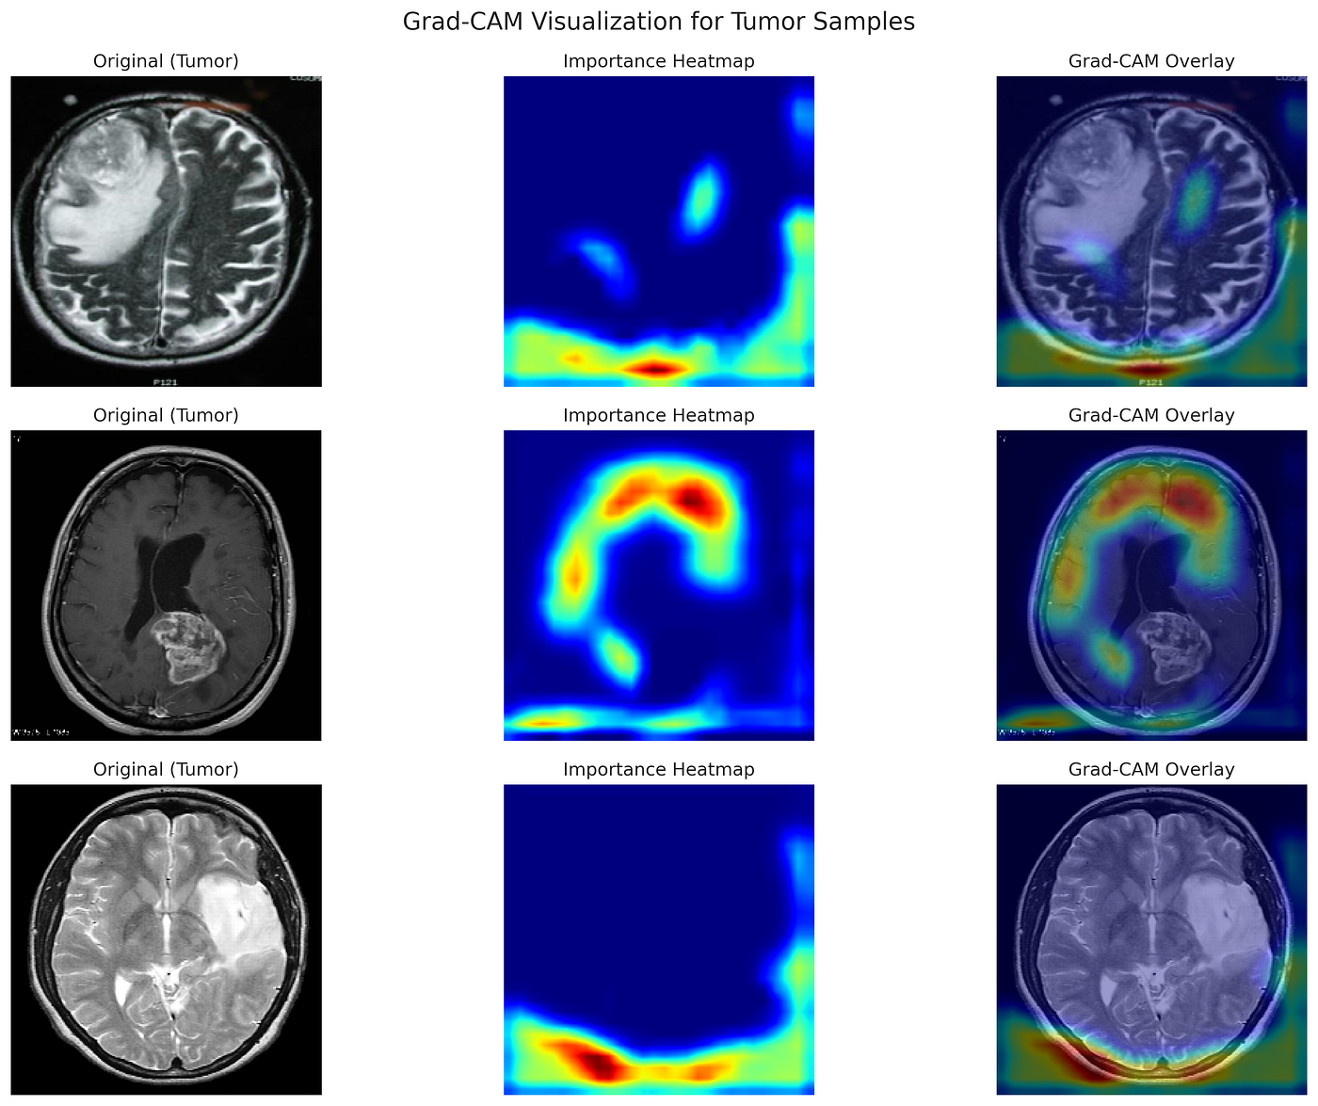




Transparent AI: From Black Box to Clinical Insight
Attention Rollout
Propagates attention weights through 12 transformer layers to identify regions of interest
Grad-CAM for ViT
Class-discriminative visualization showing model focus for specific predictions
Dual XAI Approach
Provides both global (Attention Rollout) and local (Grad-CAM) explanations
Original Image
Attention Rollout
Grad-CAM
Raw tissue sample
Global attention focus
Class-specific regions
Clinical Significance
Both methods agree on salient regions • Model focuses on malignant tissue structures
Heatmaps reveal model focuses on histological structures, not artifacts • Critical for clinical trust and adoption

Slide 7



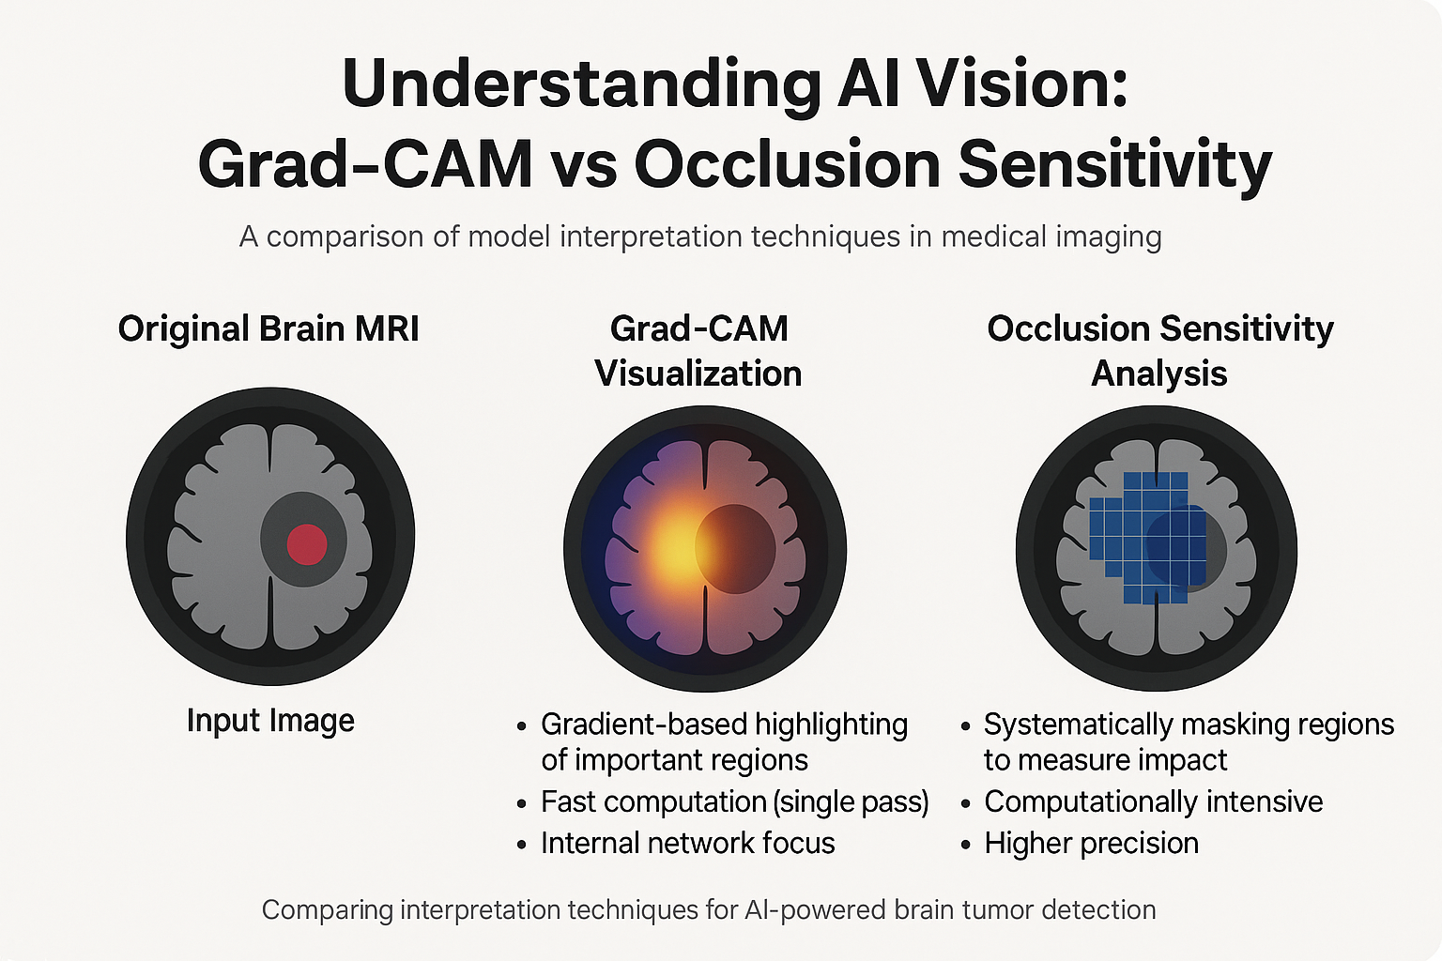


Bridging Deep Learning and Clinical Practice
Key Contributions
99.93% Colon accuracy • 99.82% Lung accuracy
Novel XAI for ViT in histopathology
Dual explanation builds clinical trust
Clinical Impact
• Explainability enables pathologist verification
• Reduces diagnostic errors & variability
• Foundation for multi-organ detection system
Future Directions
• Multi-modal fusion (histopathology + radiology + clinical)
• Extension to other cancer types
• Real-time clinical decision support
ViT-Base (Ours)
CNN Baselines

Slide 8




Dual Explanation Framework: Attention Rollout vs Grad-CAM
Attention Rollout
Type: Class-agnostic
Scope: Global focus
Layers: All 12 blocks
Fusion: Mean/Min/Max
Filter: Discard ratio for noise reduction
Grad-CAM for ViT
Type: Class-discriminative
Scope: Local regions
Source: Last block gradients
Activation: Weighted sum + ReLU
Focus: Prediction-specific features
Complementary Insights
Original Image
Attention Rollout
Grad-CAM
Raw tissue sample
Global attention flow
Class-specific focus
• Rollout: WHERE model looks overall
• Grad-CAM: WHAT drives each prediction
Dual approach confirms: Model focuses on histological structures, not artifacts • High confidence predictions correlate with precise attention
• Together: Complete explanation

Slide 9











Future Direction: Multi-Modal Cancer Classification
Histopathology Branch
ViT-B/16 → 768-dim features
High-resolution tissue analysis
Histopathology
Radiology
Clinical Data
Radiology Branch
ViT-B/16
ViT-S/16
MLP Encoder
ViT-S/16 → 384-dim features
CT / X-Ray imaging data
Feature Fusion Layer
768 + 384 + 128 = 1280 dimensions
Clinical Metadata Branch
MLP Encoder → 128-dim features
Age, smoking, stage, biomarkers
Classification Head
2-class / 3-class / Multi-class
Fusion Strategy
Concatenate: 768 + 384 + 128 = 1280 dim
Key Advantage: Combines visual patterns with clinical context → more robust, interpretable predictions for clinical decision support
Fusion MLP → Classification

Slide 10













Scalable Framework: From Lung to Multi-Organ Detection
Organ-Agnostic Pipeline
Same ViT-B/16 backbone • Custom heads • Unified XAI
Lung
Colon
Breast
Easy Extension
3 Classes
2 Classes
2 Classes
Benign • ACA • SCC
Benign • Adenocarcinoma
Benign • Malignant
1. Register new organ in config
2. Specify classes & data path
3. Auto-generate custom head
Key Benefits
Input Data
XAI Layer
Diagnosis
ViT-B/16 Engine
• Consistent XAI across organs
• Standardized metrics & evaluation
• Rapid deployment for new types
Scalable Design: build_model_for_organ('organ_name') → Auto-configure ViT + custom head + XAI tools

Slide 11





Medical-Grade Data Augmentation for Robust Training
Why Augmentation Matters
• No canonical orientation in histopathology
• Stain variation between laboratories
• Limited training data → prevent overfitting
Train-Only Augmentations
Original
Horizontal Flip
Color Jitter
RandomHorizontalFlip
RandomVerticalFlip
Raw tissue sample
Tissue rotation
Stain variation
Tissue rotation simulation
Slide orientation simulation
RandomRotation(15°)
ColorJitter
Placement variation
Staining compensation
RandomResizedCrop
Different field of view simulation
Rotation (15°)
RandomCrop
Vertical Flip
Evaluation Protocol
Slide placement
Field of view
Orientation variation
Clean transforms only: Resize + Normalize • No augmentation → Unbiased metrics
Clinical Insight: Augmentation simulates real-world variability in tissue preparation and imaging → Improves generalization to unseen clinical samples

Slide 12



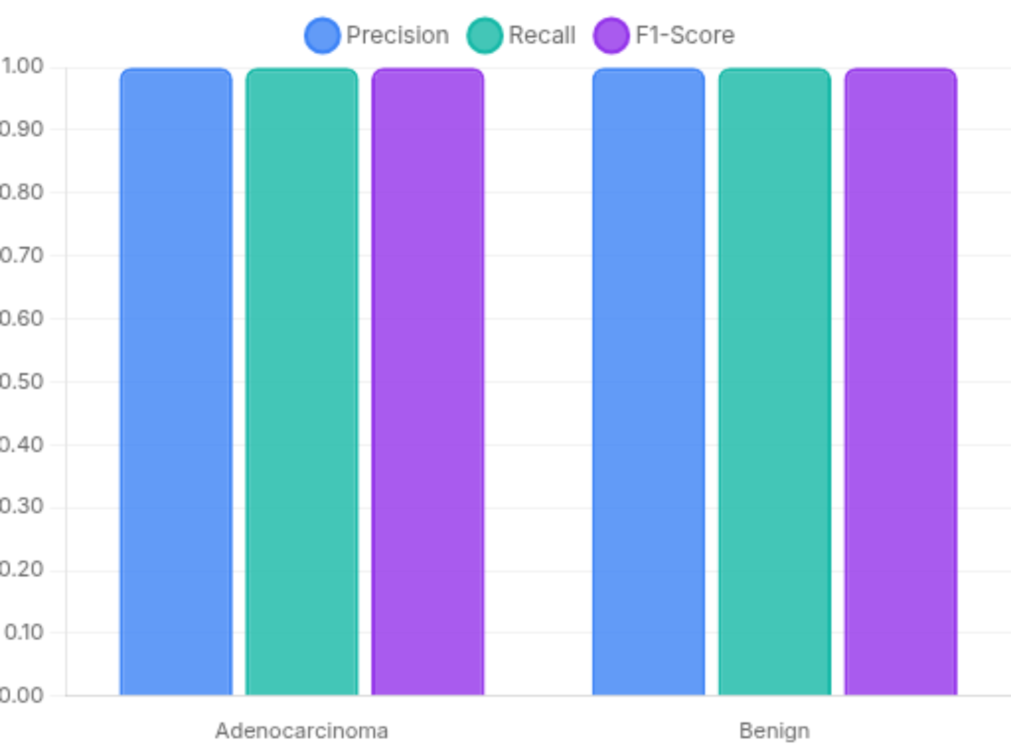
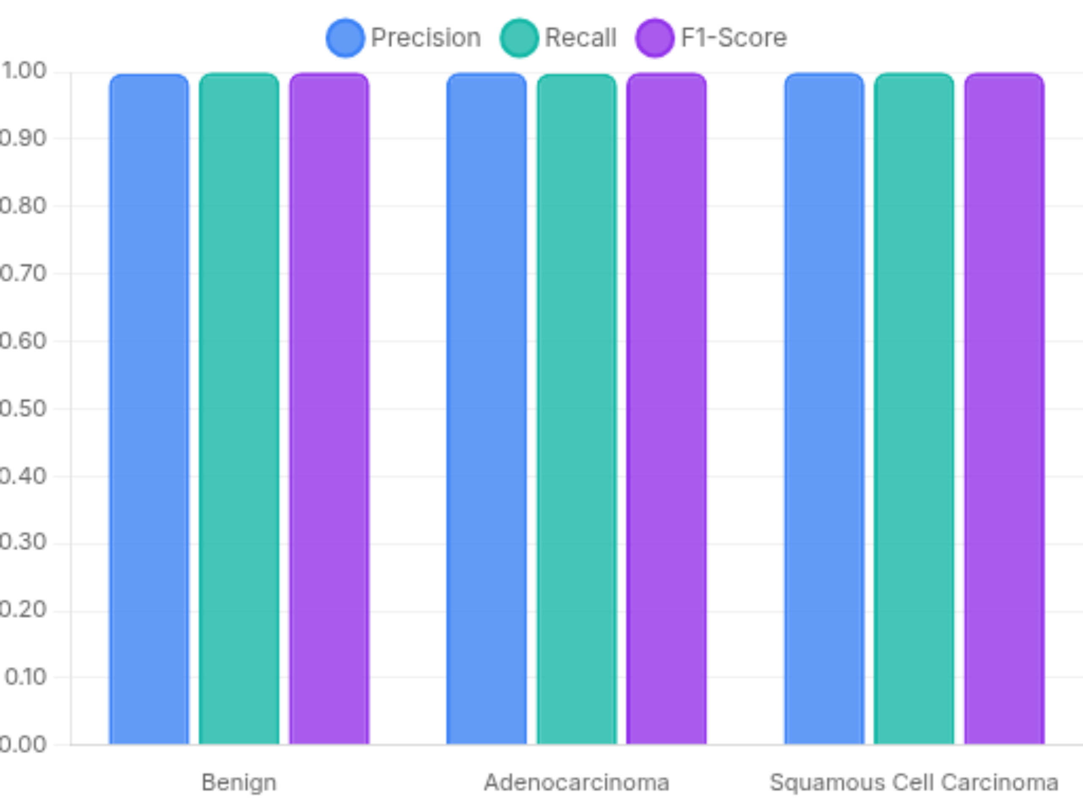

Robust Performance Across Cancer Subtypes
Key Insight: No significant performance gap between classes • Class-weighted loss ensures fairness • Macro F1 scores consistently exceed 0.998 across all subtypes

